Slide 1
Campus Parking Availability App
Group 8 - KLY Inc.
By: Mohammad Asif, Dylan Capece, Everett McCrea, Luke Padgett, Blake Stroud
Meeting times: Wednesdays at 6:20 pm - Google Hangouts video call

Slide 2



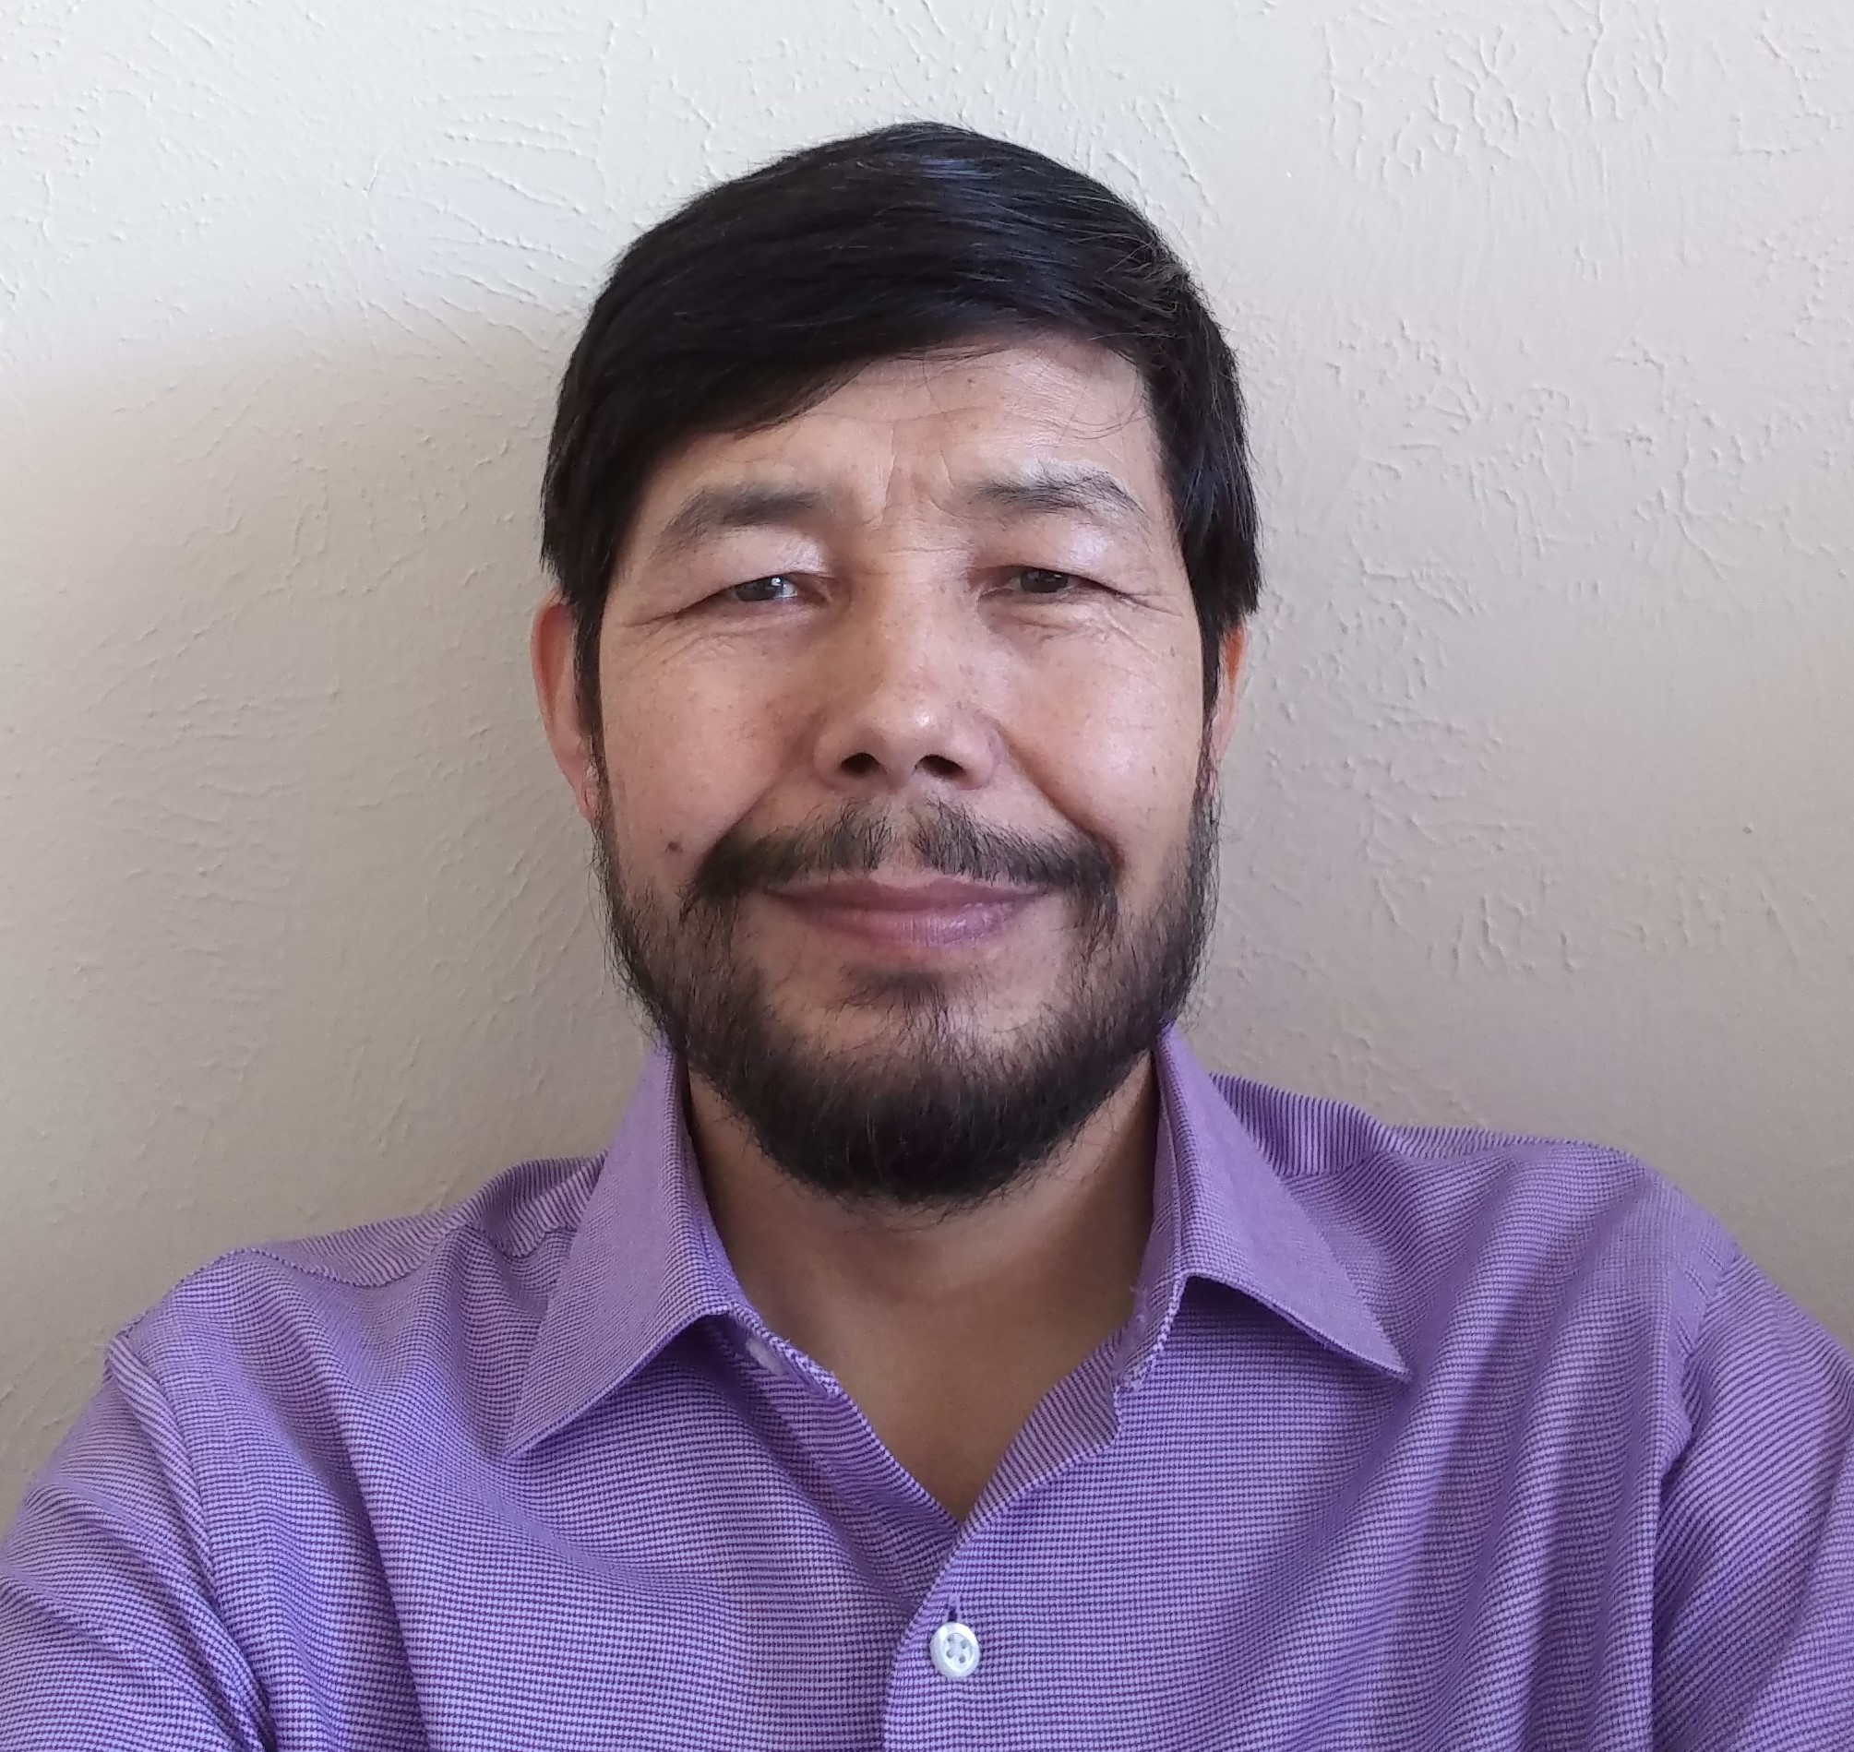

Everett McCrea
Software Engineering
Junior
Skills: Java, Cloud Computing
Job: Java Application Dev
Mohammad Asif
Software Engineering Junior
Skills: C++, Java
Job: Application Development
Luke Padgett Software Engineering Junior Skills: Java, Javascript
Job: Enterprise Java Dev
Dylan Capece
Software Engineering
Senior
Skills: Java, C++
Job: Application Development
Blake Stroud
Software Engineering
Senior
Skills: C++/C, Python
Job: Embedded Systems Engineer

Slide 3
Project Overview
App that shows real-time map of UTD parking availability
Track open spaces via car sensors and antennas at entrance of parking lot
Report number of cars in a lot to host system, then report to users
Track cars leaving parking lot
Detect which parking sticker cars have
Fix the UTD parking problem

Slide 4
Business Value
Save time and fuel
Less pollution
Increase end user satisfaction
Can charge a small fee
$2 a per week

Slide 5
Why Us
We have the necessary technical skills
Engineering and Computer Science majors
Motivated to fix a issue that affects us personally
Desire to improve the student experience
Knowledgeable of what the key issues are
Understand the potential that we can achieve with this service

Slide 6
Work Breakdown Structure
Broken down into 5 stages of software lifecycle
Requirements, Design, Development, Testing, Deployment

Slide 7
WBS: Requirements
Broken down into 5 stages of software lifecycle
Requirements, Design, Development, Testing, Deployment

Slide 8
WBS: Design
Broken down into 5 stages of software lifecycle
Requirements, Design, Development, Testing, Deployment

Slide 9
WBS: Development
Broken down into 5 stages of software lifecycle
Requirements, Design, Development, Testing, Deployment

Slide 10
WBS: Testing
Broken down into 5 stages of software lifecycle
Requirements, Design, Development, Testing, Deployment

Slide 11
WBS: Deployment
Broken down into 5 stages of software lifecycle
Requirements, Design, Development, Testing, Deployment

